Slide 1
Process Management Process Alternative - Threads
Lecture 4 (Live Version)

Slide 2
Overview
Threads:
Motivation
Basic Idea
Threads models:
Kernel vs User Thread
Hybrid model
Thread in Unix
POSIX thread:
Create, Exit, Synchronization
Exploration

Slide 3
Motivation for Thread
Process is expensive:
Process creation in the fork() model:
Duplicate memory space & process context
Context switch:
Requires saving/restoration of process Information
Communication between processes:
Independent memory space ➔ No easy way to pass information
Requires Inter-Process Communication (IPC)
Notes:
This is not justifiable if the two processes shared a lot of information, working closely together etc.

Slide 4
Motivation for Thread (cont)
Thread was invented to overcome the problems with process model
Started out as a "quick hack“
Basic Idea:
Traditional process has a single thread of control:
Only one instruction of the whole program is executing at any time
Add more threads of control to the same process:
Multiple parts of the programs is executing at the same time conceptually

Slide 5
Threads of control: Illustration
LUNCH TIME!!
int main()
{
steamRice( twoBowls );
fryFish( bigFish );
cookSoup( cornSoup );
printf( "Lunch READY!!\n" );
return 0;
}

Slide 6
Threads of control: Illustration (cont)
Single Threaded Process go through the functions sequentially
int main()
{
steamRice( twoBowls );
fryFish( bigFish );
cookSoup( cornSoup );
printf( "Lunch READY!!\n" );
return 0;
}
Single PC
Single PC
Single PC
Time

Slide 7
Multiple "threads of control" with fork( )
int result;
result = fork();
if (result != 0){
result = fork();
if (result != 0){
steamRice( twoBowls );
} else {
fryFish( bigFish );
}
} else {
cookSoup( cornSoup );
}
... ...
PC 3
int result;
result = fork();
if (result != 0){
result = fork();
if (result != 0){
steamRice( twoBowls );
} else {
fryFish( bigFish );
}
} else {
cookSoup( cornSoup );
}
... ...
PC 1
PC 1
PC 3
PC 1
int result;
result = fork();
if (result != 0){
result = fork();
if (result != 0){
steamRice( twoBowls );
} else {
fryFish( bigFish );
}
} else {
cookSoup( cornSoup );
}
... ...
PC 2
We effectively have two "threads" of control after fork()
PC 2

Slide 8
New approach: Multi-Threading
int main()
{
steamRice( twoBowls );
fryFish( bigFish );
cookSoup( cornSoup );
Wait for all threads to finish;
printf( "Lunch Ready\n");
return 0;
}
Thread 1 do steamRice( twoBowls );
PC 1
steamRice( twoBowls );
Thread 2 do steamRice( twoBowls );
PC 2
fryFish( bigFish );
Thread 3 do steamRice( twoBowls );
PC 3
cookSoup( cornSoup );

Slide 9
Process and Thread
A single process can have multiple threads:
Known as multithreaded process
Threads in the same process shares:
Memory Context: Text, Data, Heap
OS Context: Process id, other resources like files, etc
Unique information needed for each thread:
Identification (usually thread id)
Registers (General purpose and special)
“Stack” (more about this later)
Quick Check:
What can we share between threads?

Slide 10
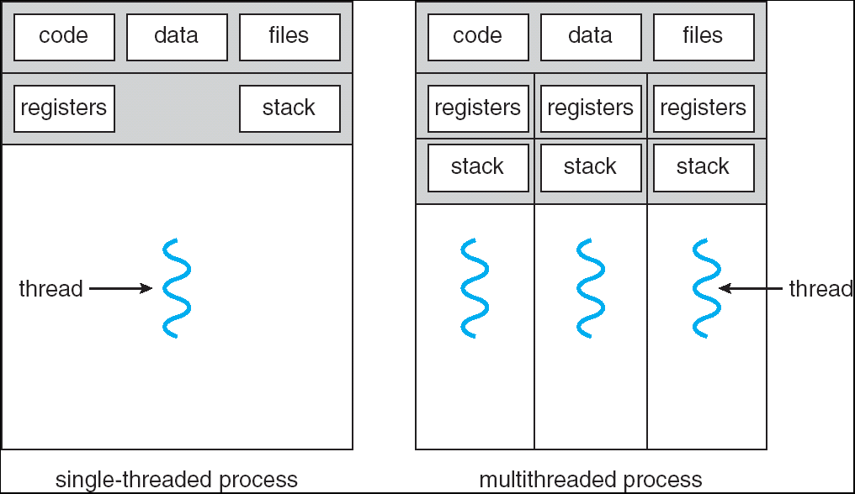
Process and Thread: Illustration

Slide 11

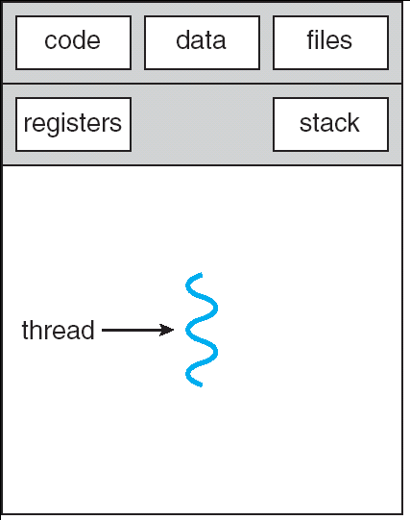
Process Context Switch VS Thread Switch

Slide 12
Threads: Benefits
Economy:
Multiple threads in the same process requires much less resources to manage compared to multiple processes
Resource sharing:
Threads share most of the resources of a process
No need for additional mechanism for passing information around
Responsiveness:
Multithreaded programs can appear much more responsive
Scalability:
Multithreaded program can take advantage of multiple CPUs

Slide 13
Thread: Problems
System Call Concurrency
Parallel execution of multiple threads ➔ parallel system call possible
Process Behavior:
Impact on process operations
Example:
fork() duplicate process, how about threads?
If a single thread executes exit(), how about the whole process?
If a single thread calls exec(), how about other threads?
Notes:
man fopen, MT-level
man fork,

Slide 14
Thread Models
What are the ways to support threads?

Slide 15
Two Major Thread Implementations
User Thread:
Thread is implemented as a user library
A runtime system (in the process) will handle thread related operation
Kernel is not aware of the threads in the process
Kernel Thread:
Thread is implemented in the OS
Thread operation is handled as system calls
Thread-level scheduling is possible:
Kernel schedule by threads, instead of by process
Kernel may make use of threads for its own execution

Slide 16
User Thread: Illustration
User Mode
Kernel Mode

Slide 17
User Thread: Pros and Cons
Advantages:
Can have multithreaded program on ANY OS
Thread operations are just library calls
Generally more configurable and flexible
e.g. Customized thread scheduling policy
Disadvantages:
OS is not aware of threads, scheduling is performed at process level
One thread blocked ➔ Process blocked ➔ All threads blocked
Cannot exploit multiple CPUs!

Slide 18
Kernel Thread: Illustration
User Mode
Kernel Mode

Slide 19
Kernel Threads: Pros and Cons
Advantages:
Kernel can schedule on thread levels:
More than 1 thread in the same process can run simultaneously on multiple CPUs
Disadvantages:
Thread operations is now a system call!
Slower and more resource intensive
Generally less flexible:
Used by all multithreaded programs
If implemented with many features:
Expensive, overkill for simple program
If implemented with few features:
Not flexible enough for some programs

Slide 20
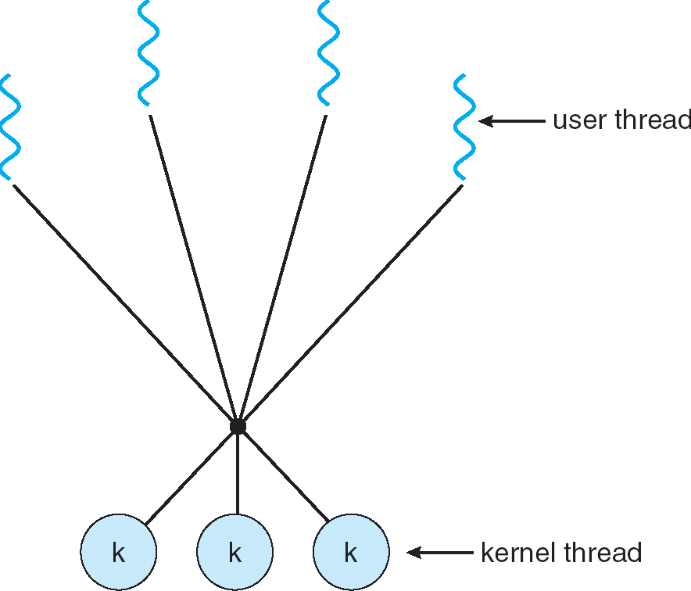
Hybrid Thread Model
Have both Kernel and User threads
OS schedule on kernel threads only
User thread can binds to a kernel thread
Offer great flexibility
Can limit the concurrency of any process / user

Slide 21
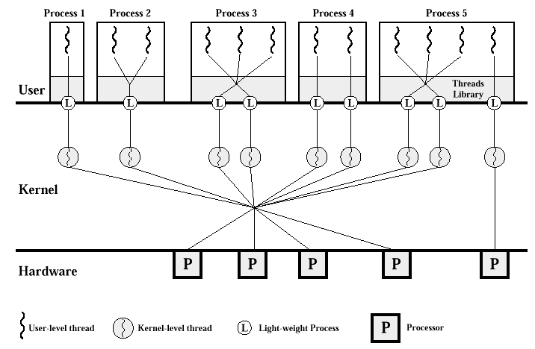
Hybrid Model Example: Solaris

Slide 22
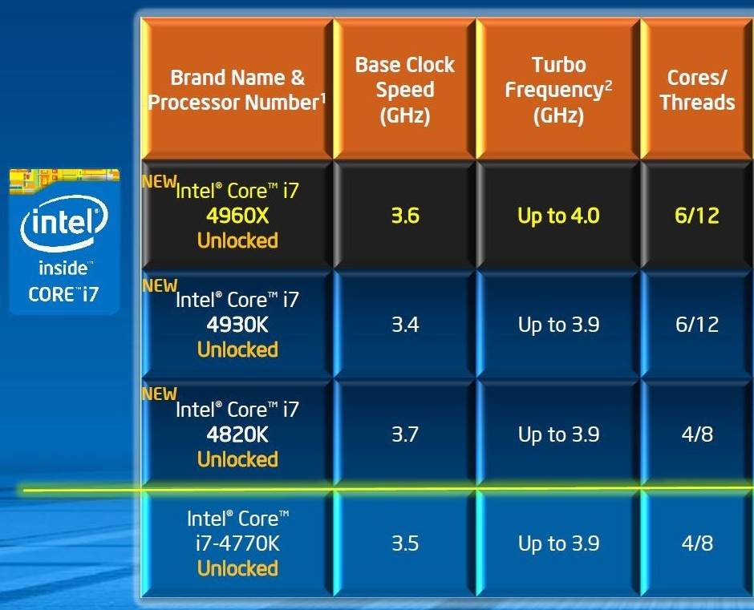
Threads on Modern Processor
Threads started off as a software mechanism
User space library ➔ OS aware mechanism
There are hardware support on modern processors:
Essentially supply multiple sets of registers (GPRs, and special registers) to allow threads to run natively and in parallel on the same core
known as simultaneous multi-threading (SMT)

Slide 23
POSIX Threads
An example thread API

Slide 24
POSIX Threads: pthread
Standard defined by the IEEE
Supported by most Unix variants
Defines the API as well as the behavior
However, implementation is not specified
So, pthread can be implemented as user / kernel thread
Will show a few example to highlight the differences between process and thread only

Slide 25
Basics of Pthread
Header File:
#include <pthread.h>
Compilation:
gcc XXXX.c –lpthread
Useful datatypes:
pthread_t : Data type to represent a thread id (TID)
pthread_attr: Data type to represents attributes of a thread

Slide 26
Pthread Creation
Thread creation syntax:
int pthread_create(
pthread_t *tidCreated,
const pthread_attr_t *threadAttributes,
void* (*startRoutine) (void*),
void *argForStartRoutine );
Returns:
0 to indicate success; !0 for errors
Parameters:
tidCreated: Thread Id for the created thread
threadAttributes: Control the behavior of the new thread
startRoutine: Function pointer to the function to be executed by thread
argForStartRoutine: Arguments for the startRoutine function

Slide 27
Pthread Termination
Thread termination syntax:
void pthread_exit( void* exitValue );
Parameters:
exitValue: Value to be returned to whoever synchronize with this thread (more later)
If pthread_exit() is not used, a pthread will terminate automatically when the end of the startRoutine is reached
In this case, there is no way to return a exit value

Slide 28
Pthread Creation & Termination: Example
//header files not shown
void* sayHello( void* arg )
{
printf("Just to say hello!\n");
pthread_exit( NULL );
}
int main()
{
pthread_t tid;
pthread_create( &tid, NULL, sayHello, NULL );
printf("Thread created with tid %i\n", tid);
return 0;
}

Slide 29
Pthread: Sharing of memory space
//header files not shown
int globalVar;
void* doSum( void* arg)
{ int i;
for (i = 0; i < 1000; i++)
globalVar++;
}
int main()
pthread_t tid[5]; //5 threads id
int i;
for (i = 0; i < 5; i++)
pthread_create( &tid[i], NULL, doSum, NULL );
printf("Global variable is %i\n", globalVar);
return 0;
}
What is the sum that we get (or should get)?

Slide 30
Pthread: Simple Synchronization
To wait for the termination of another pthread:
int pthread_join( pthread_t threadID,
void ** status);
Returns:
0 to indicate success; !0 for errors
Parameters:
threadID: TID of the pthread to wait for
status: Exit value returned by the target pthread

Slide 31
Pthread: Sharing of memory space V2.0
//header files not shown
int globalVar;
void* doSum( void* arg)
{ //same as before }
int main()
pthread_t tid[5]; //5 threads id
int i;
for (i = 0; i < 5; i++)
pthread_create( &tid[i], NULL, doSum, NULL );
//Wait for all threads to finish
for (i = 0; i < 5; i++)
pthread_join( tid[i], NULL );
printf("Global variable is %i\n", globalVar);
return 0;
}

Slide 32
Pthread: A lot more!
There are more interesting stuff about pthread:
Yielding (giving up CPU voluntarily)
Advanced synchronization
Scheduling policies
Binding to kernel threads
Etc
As we cover new topics, you can explore the pthread library to see the application!

Slide 33
Summary
Thread:
Motivation
Difference between thread and process
Thread Models:
User vs Kernel thread
Simple introduction to pthread library

Slide 34
Reference
Modern Operating System (3rd Edition)
Chapter 2.2
Operating System Concepts (7th Edition)
Chapter 4
Linux Pthread Man Pages
“man pthread……” for more

Slide 35
What can we share?
Memory
Fetch Unit
0001 | ... Text ...
... | ... .... ...
... | ... .... ...
... | ... .... ...
... | ... .... ...
Dispatch Unit
… … …
r1
... | ... Data ...
4096 |
... |
..
……
Registers
……
Functional Units
... | ... Heap ...
8000 |
... |
SP
FP
PC
... |
XXXX | ... Stack ...
XXXX |
E

Slide 37
Disclaimer: I cheated a little ☺
Accessing shared variable is much more trickier than shown!
The "globalVar++" is NOT a single machine operation:
Read globalVar from memory
Increase globalVar
Store globalVar back to memory
What if a thread is switched out in step 2?
So, a small number of iterations is chosen to avoid thread switching in middle ☺
E

Slide 38
Process Context Switch VS Thread Switch
Process context switch involves:
OS Context
Hardware Context
Memory Context
Thread switch within the same process involves:
Hardware context:
Registers
"Stack" (actually just changing FP and SP registers)
Thread is much “lighter” than process:
a.k.a. lightweight process
E

